Slide 1
How to calculate volumes
Here a simple guide on how to calculate volumes

Slide 2
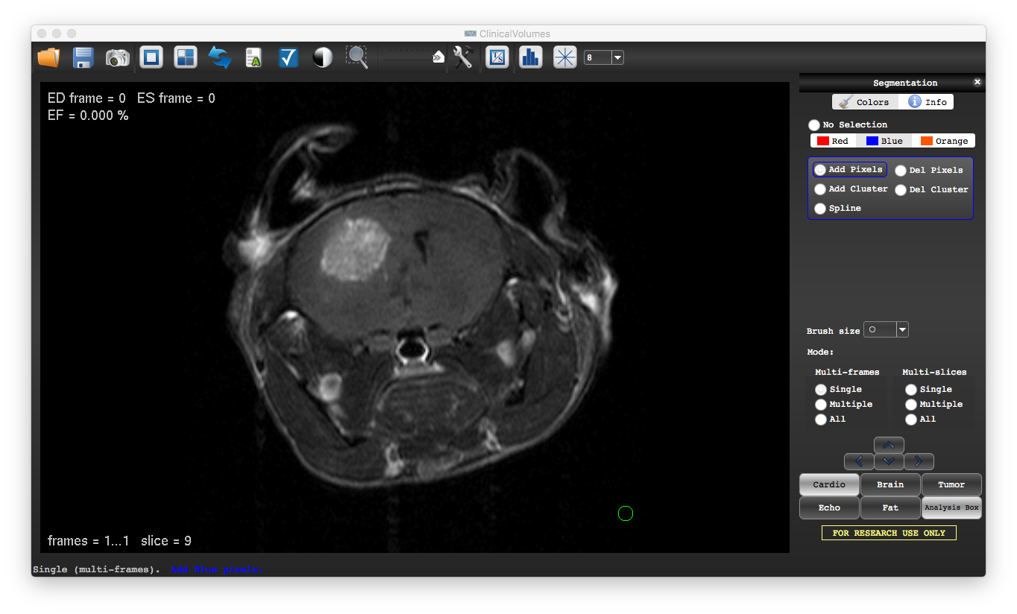
The volume of a tumor can be achieved as follows:
Open the dataset
Choose the “Blue” color and select “Add pixels”

Slide 3
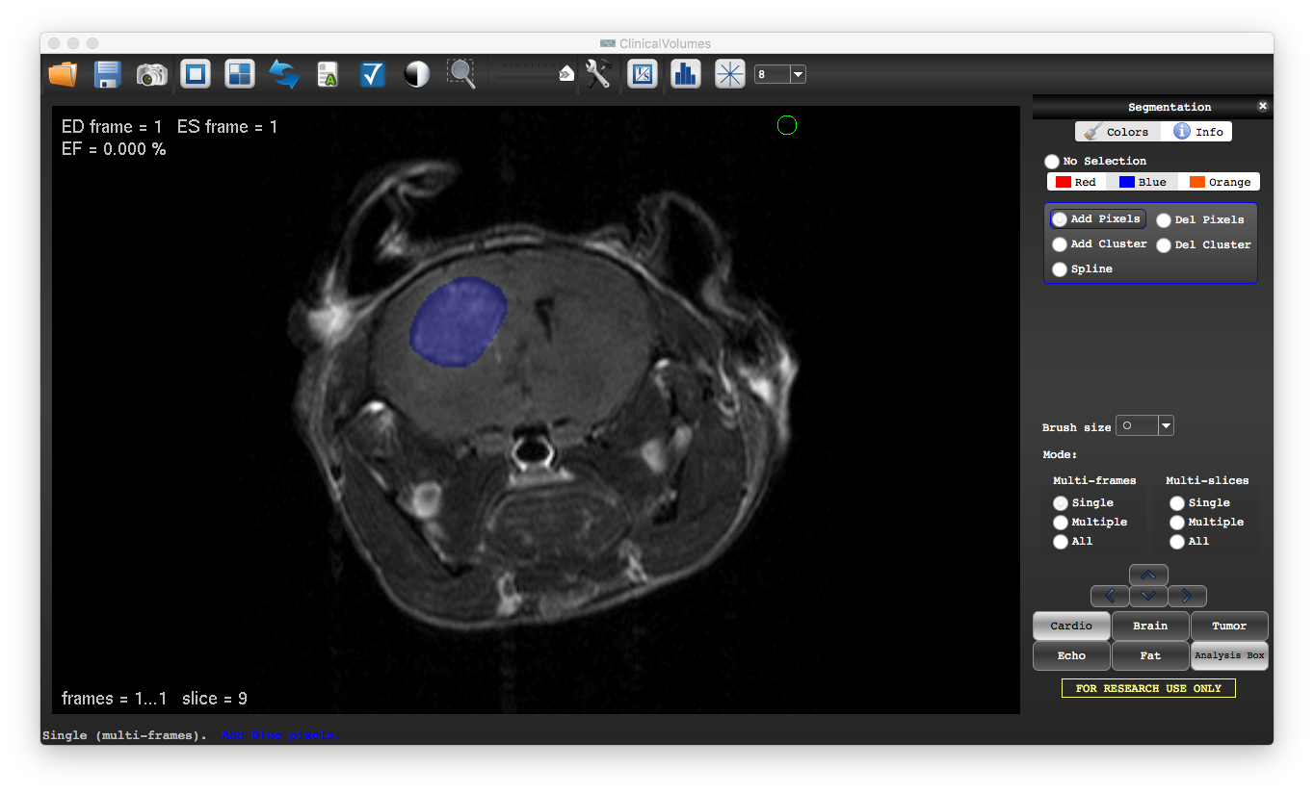
3) With left button of the mouse apply the color to cover the tumor (being in “Single” mode)
4) Move slice with the arrows to fill all the slices with tumor
5) Save the data with the “Save results” command

Slide 4
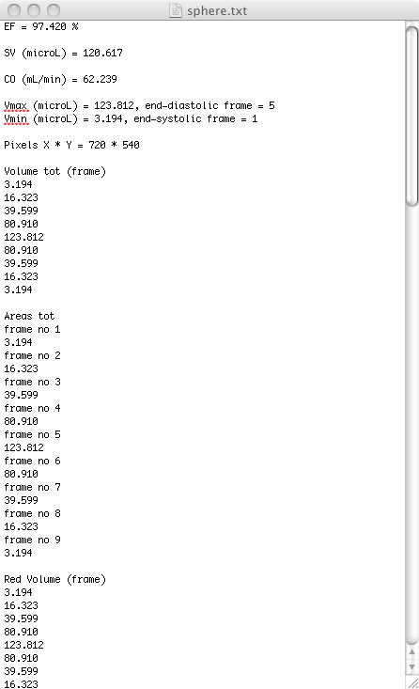
When opening the saved text file
Refer to “A guide to image segmentation → 3) How to Save Results”
9) This section identify the total volume respective to each frame of the dataset in mm3. In this particular dataset we have 9 frames 1 slice
10) This section identify the total areas respective to each frame of the dataset in mm2.
Remember that such areas are not color related. The sum of all the colors is included for each frame.
11) Red volume of each frame of the dataset in mm3. These volumes are color-specific

Slide 5
12) The volumes are always reported in mm3 and calculated as:
volume = cluster area * slice thickness
13) Areas are always reported in mm2 and automatically resolved. ClinicalVolume calculates the area of a cluster as follows:
Image resolution = FOV / matrix size (in the X and Y direction)
Cluster area = Image resolution * number of pixels filled by a color
Note: if the information provided as slice thickness and FOV are incorrect, volumes and cluster areas will also result incorrect.

